Slide 1
Network Layer_2

Slide 2
Chapter 4: outline
4.1 introduction
4.2 virtual circuit and datagram networks
4.3 what’s inside a router
4.4 IP: Internet Protocol
datagram format
IPv4 addressing
ICMP
IPv6
4.5 routing algorithms
link state
distance vector
hierarchical routing
4.6 routing in the Internet
RIP
OSPF
BGP
4.7 broadcast and multicast routing

Slide 3
Interplay between routing, forwarding
routing algorithm determines
end-end-path through network
routing algorithm
forwarding table determines
local forwarding at this router
local forwarding table
dest address
output link
address-range 1
address-range 2
address-range 3
address-range 4
3
2
2
1
IP destination address in
arriving packet’s header
1
3
2

Slide 4
Graph abstraction
5
v
3
w
2
5
u
2
1
z
3
1
2
x
y
1
graph: G = (N,E)
N = set of routers = { u, v, w, x, y, z }
E = set of links ={ (u,v), (u,x), (v,x), (v,w), (x,w), (x,y), (w,y), (w,z), (y,z) }
aside: graph abstraction is useful in other network contexts, e.g.,
P2P, where N is set of peers and E is set of TCP connections

Slide 5
Graph abstraction: costs
5
c(x,x’) = cost of link (x,x’)
e.g., c(w,z) = 5
cost could always be 1, or
inversely related to bandwidth,
or inversely related to
congestion
v
3
w
2
5
u
2
1
z
3
1
2
x
y
1
cost of path (x₁, x₂, x₃,…, x_{p}) = c(x₁,x₂) + c(x₂,x₃) + … + c(x_{p-1},x_{p})
key question: what is the least-cost path between u and z ?
routing algorithm: algorithm that finds that least cost path

Slide 6
Routing algorithm classification
Q: global or decentralized information?
global:
all routers have complete topology, link cost info
“link state” algorithms
decentralized:
router knows physically-connected neighbors, link costs to neighbors
iterative process of computation, exchange of info with neighbors
“distance vector” algorithms
Q: static or dynamic?
static:
routes change slowly over time
dynamic:
routes change more quickly
periodic update
in response to link cost changes

Slide 7
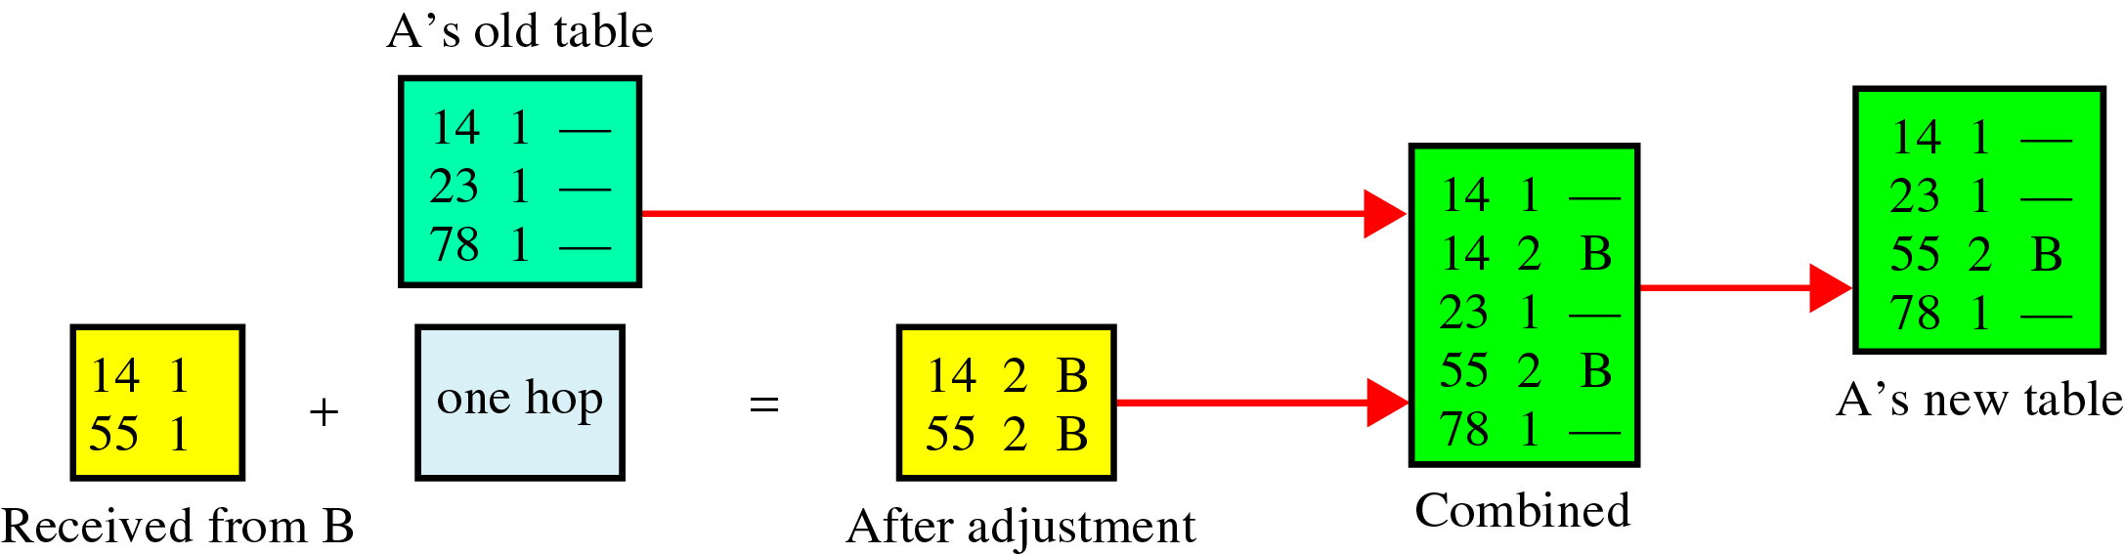
Updating Routing Table for Router A

Slide 8
5
3
v
w
2
5
u
2
z
1
3
1
x
2
y
1

Slide 9
Distance Vector vs. Link State
Distance Vector:
Vector of distances to all nodes, e.g., u: {u:0, v:2, w:5, x:1, y:2, z:4}
Sent to neighbors, e.g., u will send to v, w, x
Large vectors to small # of nodes Tell about the world to neighbors
Older method. Used in RIP.
Link State:
Vector of link cost to neighbors, e.g, u: {v:2, w:5, x:1}
Sent to all nodes, e.g., u will send to v, w, x, y, z
Small vectors to large # of nodes Tell about the neighbors to the world
Newer method. Used in OSPF.

Slide 10
Chapter 4: outline
4.1 introduction
4.2 virtual circuit and datagram networks
4.3 what’s inside a router
4.4 IP: Internet Protocol
datagram format
IPv4 addressing
ICMP
IPv6
4.5 routing algorithms
link state
distance vector
hierarchical routing
4.6 routing in the Internet
RIP
OSPF
BGP
4.7 broadcast and multicast routing

Slide 11
A Link-State Routing Algorithm
Dijkstra’s algorithm
net topology, link costs known to all nodes
accomplished via “link state broadcast”
all nodes have same info
computes least cost paths from one node (‘source”) to all other nodes
gives forwarding table for that node
iterative: after k iterations, know least cost path to k dest.’s
notation:
c(x,y): link cost from node x to y; = ∞ if not direct neighbors
D(v): current value of cost of path from source to dest. v
p(v): predecessor node along path from source to v
N': set of nodes whose least cost path definitively known

Slide 12
Dijsktra’s Algorithm
1 Initialization:
2 N' = {u}
3 for all nodes v
4 if v adjacent to u
5 then D(v) = c(u,v)
6 else D(v) = ∞
7
8 Loop
9 find w not in N' such that D(w) is a minimum
10 add w to N'
11 update D(v) for all v adjacent to w and not in N' :
12 D(v) = min( D(v), D(w) + c(w,v) )
13 /* new cost to v is either old cost to v or known
14 shortest path cost to w plus cost from w to v */
15 until all nodes in N'

Slide 13
Dijkstra’s Algorithm
Goal: Find the least cost paths from a given node to all other nodes in the network
Notation: c(i,j) = Link cost from i to j if i and j are connected D(k) = Total path cost from s to k N’ = Set of nodes so far for which the least cost path is known
Method:
Initialize: N’={u}, D(v) = c(u,v) for all neighbors of u
Repeat until N includes all nodes:
Find node w∉ N’, whose D(w) is minimum
Add w to N’
D(v) = min[D(v), D(w) + c(w,v)] for all v ∉ N’

Slide 14
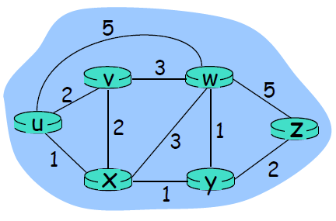
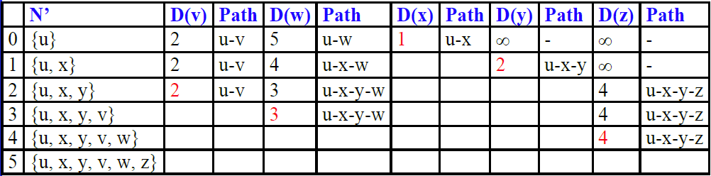
Dijkstra’s Algorithm: Example

Slide 15
Dijkstra’s algorithm: example (2)
resulting shortest-path tree from u:
v
w
u
z
x
y
resulting forwarding table in u:
destination
link
v
(u,v)
x
(u,x)
y
(u,x)
w
(u,x)
z
(u,x)

Slide 16
Dijkstra’s algorithm, discussion
algorithm complexity: n nodes
each iteration: need to check all nodes, w, not in N
n(n+1)/2 comparisons: O(n²)
more efficient implementations possible: O(nlogn)
oscillations possible:
e.g., support link cost equals amount of carried traffic:

Slide 17
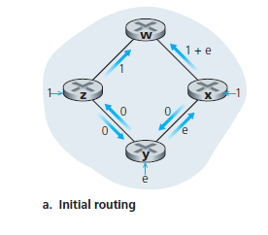
A pathology of LS
Figure shows a simple network topology where link costs are equal to the load carried on the link, for example, reflecting the delay that would be experienced.
Node z originates a unit of traffic destined for w, node x also originates a unit of traffic destined for w, and node y injects an amount of traffic equal to e, also destined for w. The initial routing is shown in Figure 4.29(a) with the link costs corresponding to the amount of traffic carried.

Slide 18
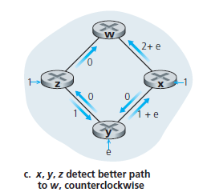
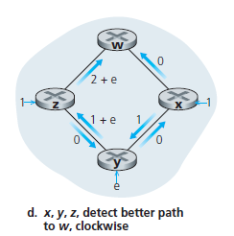
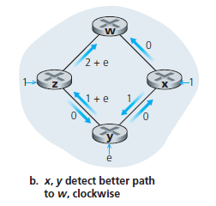
a pathology of LS
When the LS algorithm is next run, node y determines (based on the link costs shown in Figure 4.29(a)) that the clockwise path to w has a cost of 1, while the counterclockwise path to w (which it had been using) has a cost of 1 + e. Hence y’s least-cost path to w is now clockwise.
Similarly, x determines that its new least-cost path to w is also clockwise, resulting in costs shown in Figure 4.29(b).
When the LS algorithm is run next, nodes x, y, and z all detect a zero-cost path to w in the counterclockwise direction, and all route their traffic to the counterclockwise routes. The next time the LS algorithm is run, x, y, and z all then route their traffic to the clockwise routes.

Slide 19
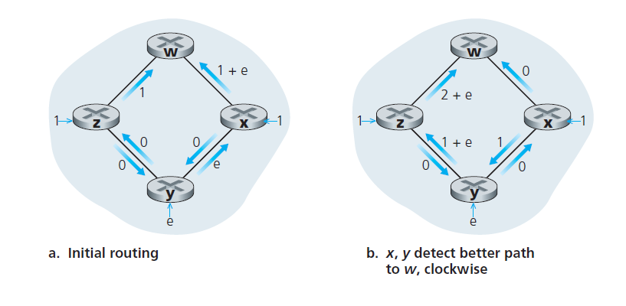
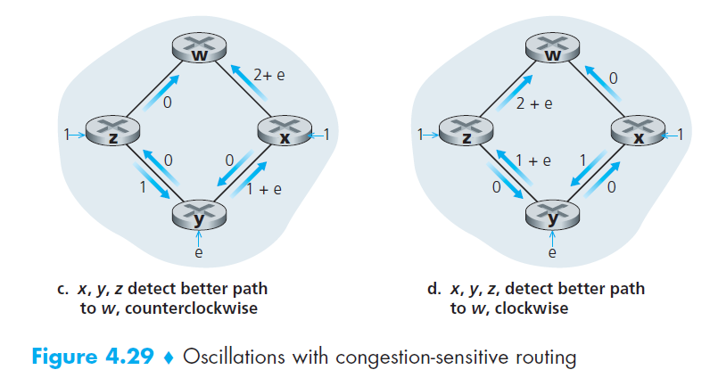

Slide 20
Complexity and Oscillations
Algorithm complexity: n nodes
Each iteration: need to check all nodes, w, not in N
n(n+1)/2 comparisons: O(n2)
More efficient implementations possible: O(n log n)
Oscillations Possible: e.g., support link cost equals amount of carried traffic

Slide 21
Chapter 4: outline
4.1 introduction
4.2 virtual circuit and datagram networks
4.3 what’s inside a router
4.4 IP: Internet Protocol
datagram format
IPv4 addressing
ICMP
IPv6
4.5 routing algorithms
link state
distance vector
hierarchical routing
4.6 routing in the Internet
RIP
OSPF
BGP
4.7 broadcast and multicast routing

Slide 22
Distance vector algorithm
Bellman-Ford equation (dynamic programming)
let
d_{x}(y) := cost of least-cost path from x to y
then
d_{x}(y) = min {c(x,v) + d_{v}(y) }
v
cost from neighbor v to destination y
cost to neighbor v
min taken over all neighbors v of x

Slide 23
Bellman-Ford example
clearly, d_{v}(z) = 5, d_{x}(z) = 3, d_{w}(z) = 3
5
3
B-F equation says:
v
w
2
5
u
2
z
d_{u}(z) = min { c(u,v) + d_{v}(z),
c(u,x) + d_{x}(z),
c(u,w) + d_{w}(z) }
= min {2 + 5,
1 + 3,
5 + 3} = 4
3
1
1
2
x
y
1
node achieving minimum is next
hop in shortest path, used in forwarding table

Slide 24
Distance vector algorithm
D_{x}(y) = estimate of least cost from x to y
x maintains distance vector D_{x} = [D_{x}(y): y є N ]
node x:
knows cost to each neighbor v: c(x,v)
maintains its neighbors’ distance vectors. For each neighbor v, x maintains D_{v} = [D_{v}(y): y є N ]

Slide 25
Distance vector algorithm
key idea:
from time-to-time, each node sends its own distance vector estimate to neighbors
when x receives new DV estimate from neighbor, it updates its own DV using B-F equation:
D_{x}(y) ← min_{v}{c(x,v) + D_{v}(y)} for each node y ∊ N
under minor, natural conditions, the estimate D_{x}(y) converge to the actual least cost d_{x}(y)

Slide 26
Distance vector algorithm
iterative, asynchronous: each local iteration caused by:
local link cost change
DV update message from neighbor
distributed:
each node notifies neighbors only when its DV changes
neighbors then notify their neighbors if necessary
each node:
wait for (change in local link cost or msg from neighbor)
recompute estimates
if DV to any dest has changed, notify neighbors

Slide 27
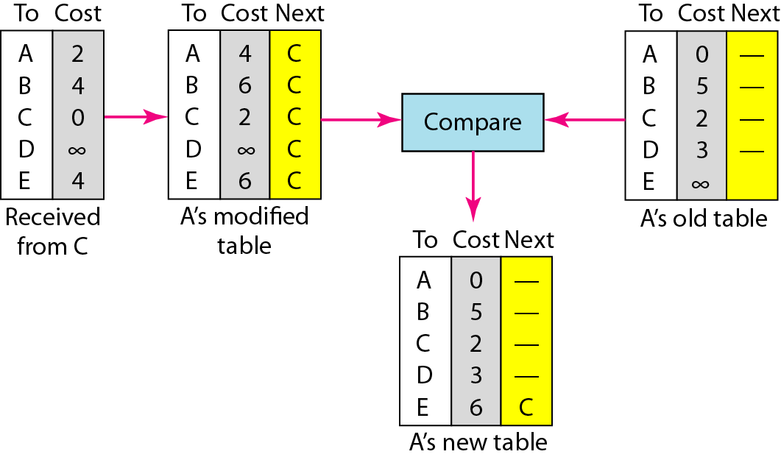
Figure Updating in distance vector routing

Slide 28
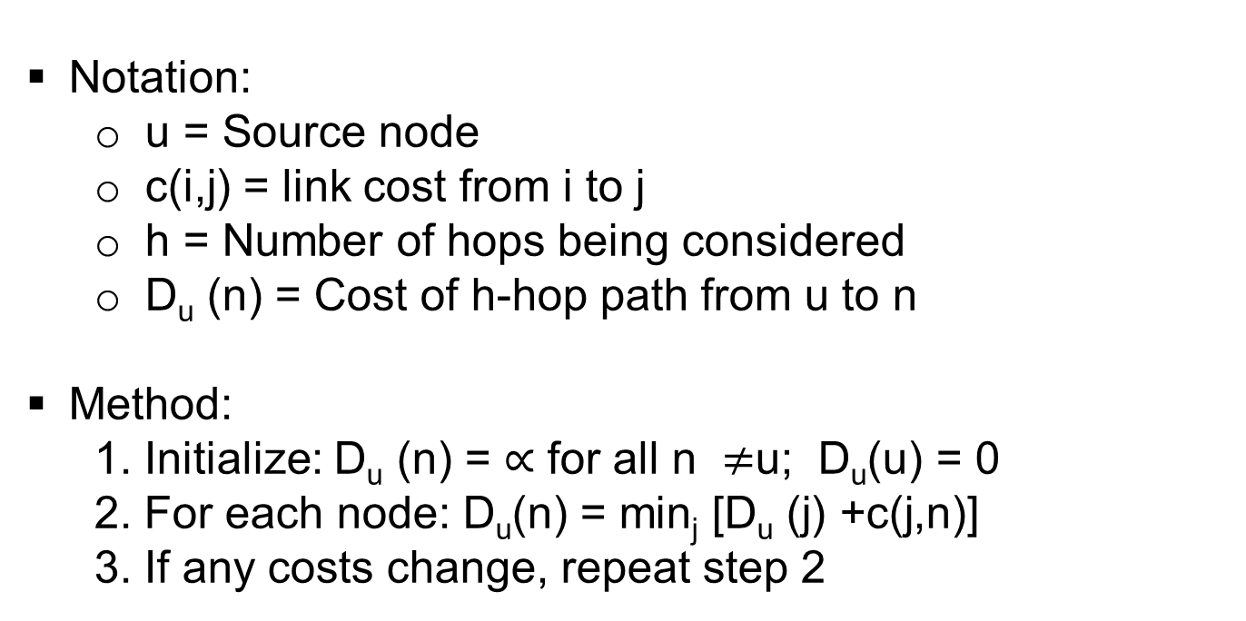
Bellman-Ford Algorithm
Notation:
u = Source node
c(i,j) = link cost from i to j
h = Number of hops being considered
D_{u} (n) = Cost of h-hop path from u to n
Method:
1. Initialize: D_{u} (n) = $∝$ for all n $≠$u; D_{u}(u) = 0
2. For each node: D_{u}(n) = min_{j} [D_{u} (j) +c(j,n)]
3. If any costs change, repeat step 2

Slide 29
D_{x}(z) = min{c(x,y) + D_{y}(z), c(x,z) + D_{z}(z)}
= min{2+1 , 7+0} = 3
D_{x}(y) = min{c(x,y) + D_{y}(y), c(x,z) + D_{z}(y)} = min{2+0 , 7+1} = 2
node x
table
cost to
cost to
x y z
x y z
x
0 2 7
x
0
2
3
y
y
2 0 1
from
∞
∞
∞
from
z
∞
∞
∞
z
7 1 0
node y
table
cost to
x y z
y
2
1
x
∞
∞
z
∞
2 0 1
x
from
y
7
z
∞
∞
∞
node z
table
cost to
x y z
x
∞ ∞ ∞
from
y
∞
∞
∞
z
7
1
0
time

Slide 30
D_{x}(z) = min{c(x,y) + D_{y}(z), c(x,z) + D_{z}(z)}
= min{2+1 , 7+0} = 3
D_{x}(y) = min{c(x,y) + D_{y}(y), c(x,z) + D_{z}(y)} = min{2+0 , 7+1} = 2
node x
table
cost to
cost to
cost to
x y z
x y z
x y z
x
0 2 7
x
0
2
3
x
0 2 3
y
y
2 0 1
from
∞
∞
∞
from
y
2 0 1
z
z
from
∞
∞
∞
7 1 0
z
3 1 0
node y
table
cost to
cost to
cost to
x y z
x y z
x y z
y
2
1
x
∞
∞
x
0 2 7
∞
2 0 1
x
0 2 3
x
z
from
y
y
2 0 1
y
7
from
from
2 0 1
z
∞
∞
∞
z
7 1 0
z
3 1 0
node z
table
cost to
cost to
cost to
x y z
x y z
x y z
x
∞ ∞ ∞
x
0 2 7
x
0 2 3
y
y
2 0 1
from
y
∞
∞
from
2 0 1
from
∞
z
z
3 1 0
z
3 1 0
7
1
0
time
time

Slide 31
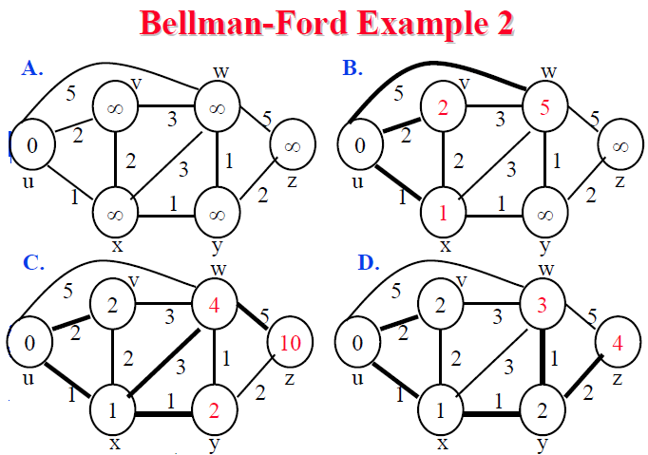

Slide 32
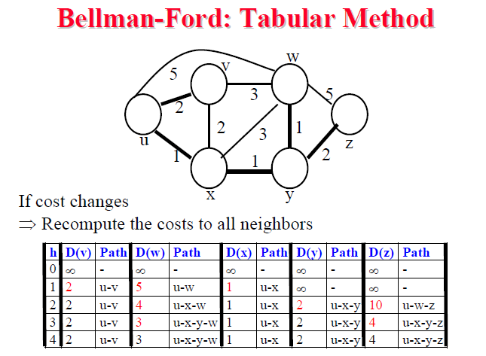

Slide 33
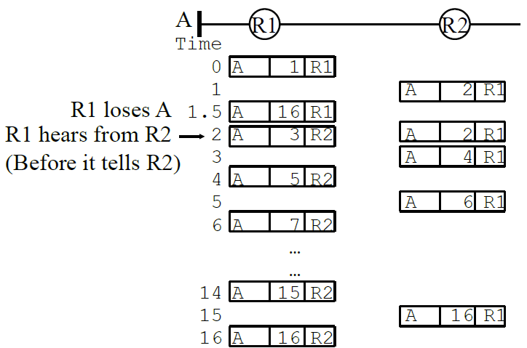
Counting to Infinity Problem

Slide 34
Distance vector: link cost changes
link cost changes:
node detects local link cost change
updates routing info, recalculates distance vector
if DV changes, notify neighbors
1
y
4
1
x
z
50
“good
news
travels
fast”
t₀ : y detects link-cost change, updates its DV, informs its neighbors.
t₁ : z receives update from y, updates its table, computes new least cost to x , sends its neighbors its DV.
t₂ : y receives z’s update, updates its distance table. y’s least costs do not change, so y does not send a message to z.

Slide 35
Distance vector: link cost changes
link cost changes:
node detects local link cost change
bad news travels slow - “count to infinity” problem!
44 iterations before algorithm stabilizes: see text
60
y
4
1
x
z
50
poisoned reverse:
If Z routes through Y to get to X :
Z tells Y its (Z’s) distance to X is infinite (so Y won’t route to X via Z)
will this completely solve count to infinity problem?

Slide 36
Distance-Vector Algorithm: Adding Poisoned Reverse
The specific looping scenario just described can be avoided using a technique known as poisoned reverse.
—if z routes through y to get to destination x, then z will advertise to y that its distance to x is infinity.

Slide 37
Comparison of LS and DV algorithms
message complexity
LS: with n nodes, E links, O(nE) msgs sent
DV: exchange between neighbors only
convergence time varies
speed of convergence
LS: O(n²) algorithm requires O(nE) msgs
may have oscillations
DV: convergence time varies
may be routing loops
count-to-infinity problem
robustness: what happens if router malfunctions?
LS:
node can advertise incorrect link cost
each node computes only its own table
DV:
DV node can advertise incorrect path cost
each node’s table used by others
error propagate thru network

Slide 38
Summary
Distance Vectors: Distance to all nodes in the network sent to neighbors. Small # of large messages.
Link State: Cost of link to neighbors sent to entire network. Large # of small messages.
Dijkstra’s algorithm is used to compute shortest path using link state
Bellman Ford’s algorithm is used to compute shortest paths using distance vectors
Distance Vector algorithms suffer from the count-to-infinity problem

Slide 39
Chapter 4: outline
4.1 introduction
4.2 virtual circuit and datagram networks
4.3 what’s inside a router
4.4 IP: Internet Protocol
datagram format
IPv4 addressing
ICMP
IPv6
4.5 routing algorithms
link state
distance vector
hierarchical routing
4.6 routing in the Internet
RIP
OSPF
BGP
4.7 broadcast and multicast routing

Slide 40
Routing Protocols
Autonomous Systems (AS)
Routing Information Protocol (RIP)
3. Open Shortest Path First (OSPF)
OSPF Areas
4. Border Gateway Protocol (BGP)

Slide 41
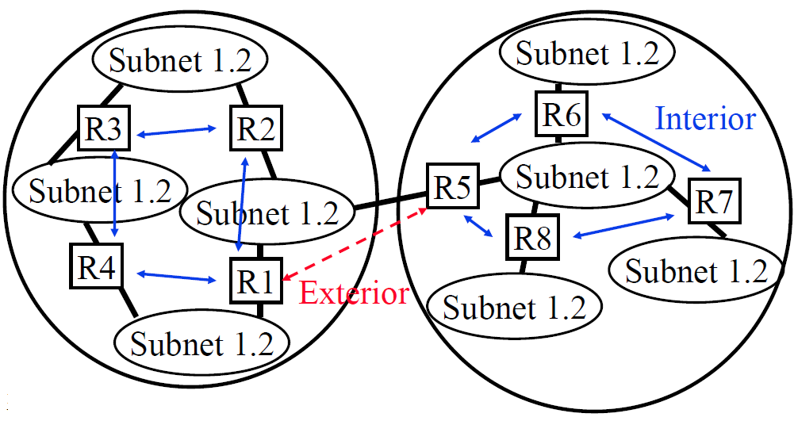
Autonomous Systems
An internet connected by homogeneous routers under the administrative control of a single entity

Slide 42
Routing Protocols
Interior Router Protocol (IRP): Used for passing routing information among routers internal to an autonomous system. Also known as IGP.
Examples: RIP, OSPF, IGRP
Exterior Router Protocol (ERP): Used for passing routing information among routers between autonomous systems. Also known as EGP.
Examples: EGP, BGP, IDRP
EGP is a class as well as an instance in that class.

Slide 43
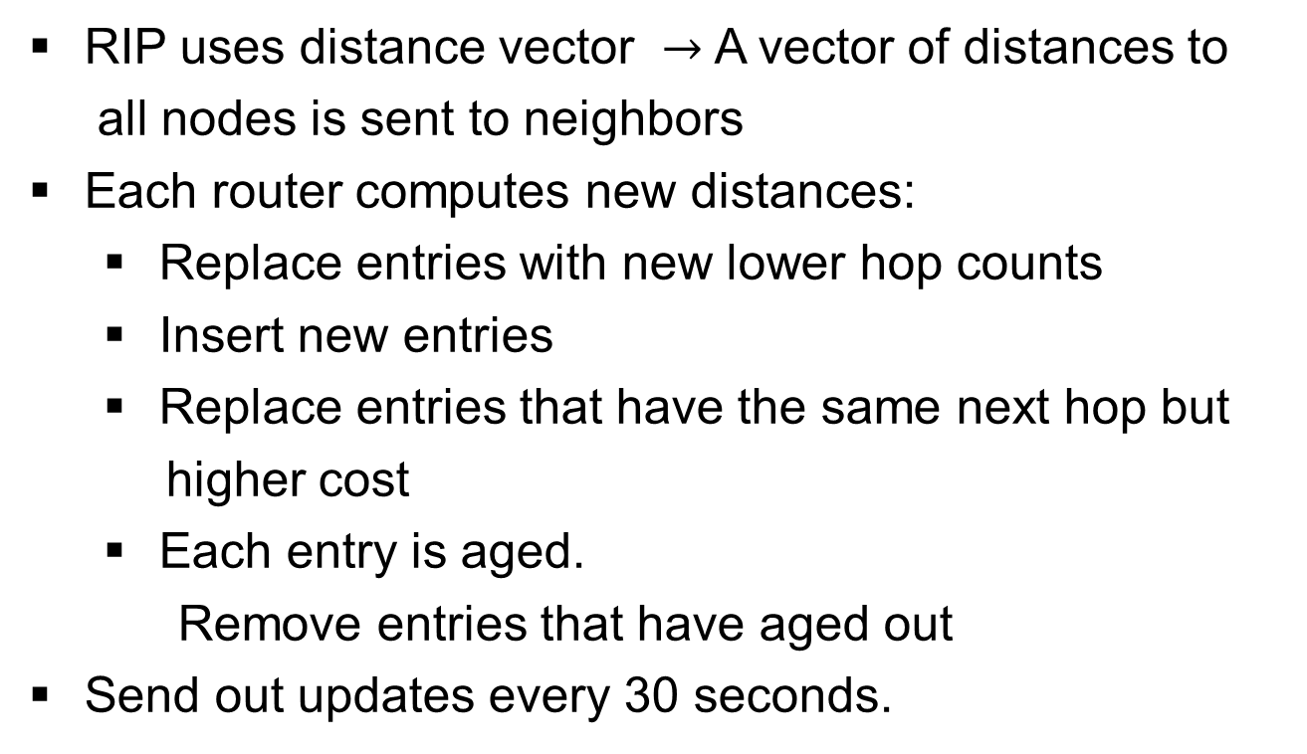
Routing Information Protocol
RIP uses distance vector $→$ A vector of distances to
all nodes is sent to neighbors
Each router computes new distances:
Replace entries with new lower hop counts
Insert new entries
Replace entries that have the same next hop but
higher cost
Each entry is aged.
Remove entries that have aged out
Send out updates every 30 seconds.

Slide 44
Shortcomings of RIP
Maximum network diameter = 15 hops
Cost is measured in hops
Only shortest routes. May not be the fastest route.
Entire tables are broadcast every 30 seconds.
Bandwidth intensive.
Uses UDP with 576-byte datagrams.
Need multiple datagrams.
300-entry table needs 12 datagrams.
An error in one routing table is propagated to all routers
Slow convergence

Slide 45
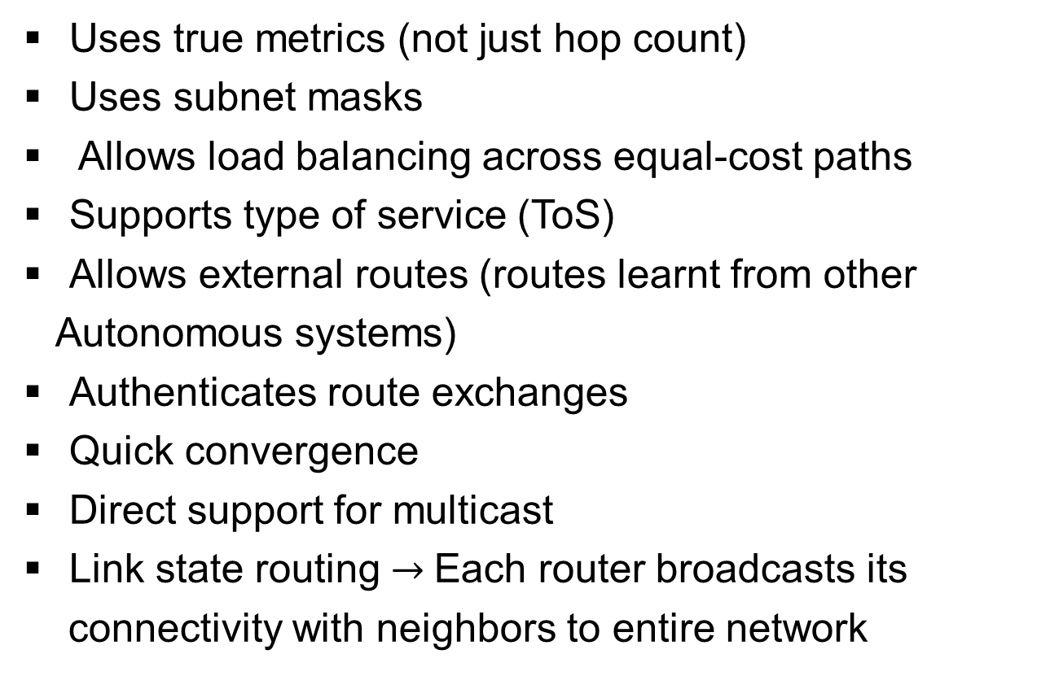
Open Shortest Path First (OSPF)
Uses true metrics (not just hop count)
Uses subnet masks
Allows load balancing across equal-cost paths
Supports type of service (ToS)
Allows external routes (routes learnt from other
Autonomous systems)
Authenticates route exchanges
Quick convergence
Direct support for multicast
Link state routing $→$Each router broadcasts its
connectivity with neighbors to entire network

Slide 46
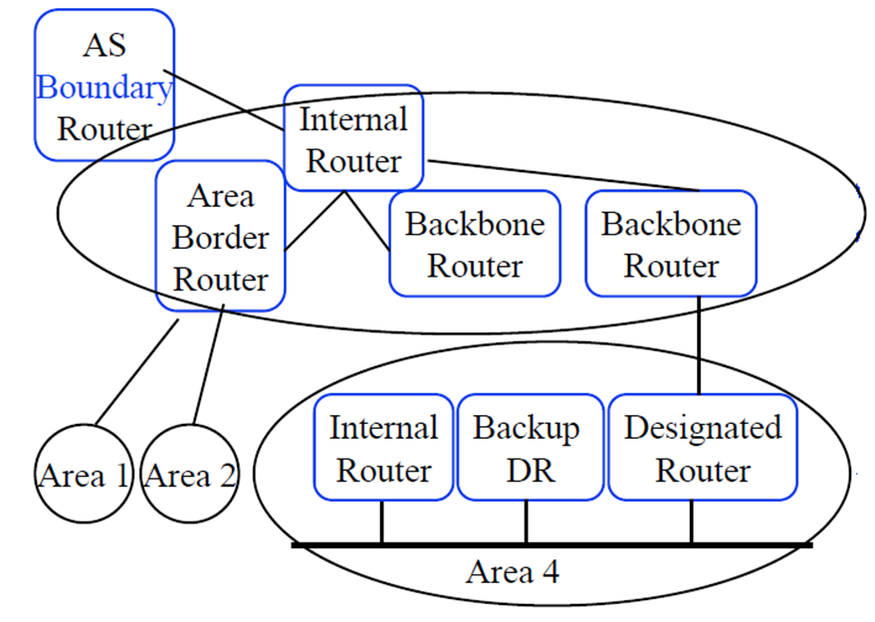
Router Types

Slide 47
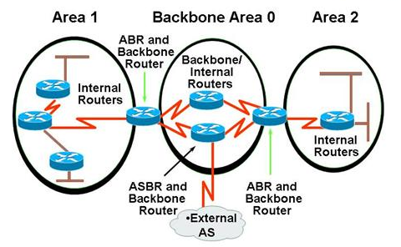

Slide 48
Router Types
Internal Router (IR): All interfaces belong to the same area
Area Border Router (ABR): Interfaces to multiple areas
Backbone Router (BR): Interfaces to the backbone
Autonomous System Boundary Router (ASBR):
Exchanges routing info with other autonomous systems
Designated Router (DR): Generates link-state info
about the subnet
Backup Designated Router (BDR): Becomes DR if DR fails.

Slide 49
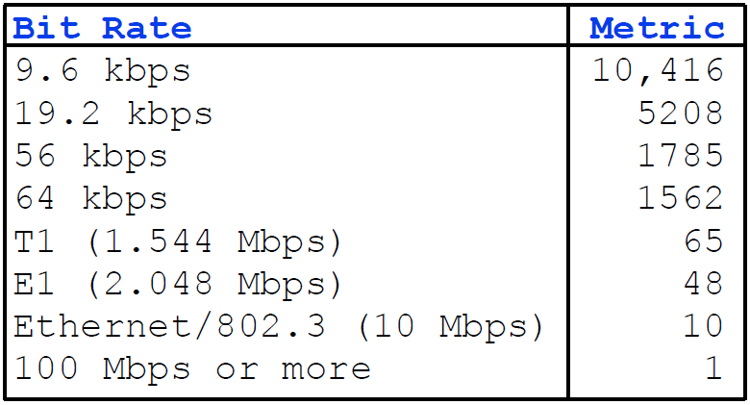
Metrics (Cost)
RFC 1253: Metric = 108/Speed

Slide 50
Maintaining the Database
Databases are continually checked for synchronization
by flooding LSAs
All flooded LSAs are acked. Unacked LSAs are flooded again.
Database information is checked. If new info, it is forwarded to other adjacencies using LSAs.
When an entry is aged out, the info is flooded.
Dijkstra's algorithm is run on every new info, to build
new routing tables.

Slide 51
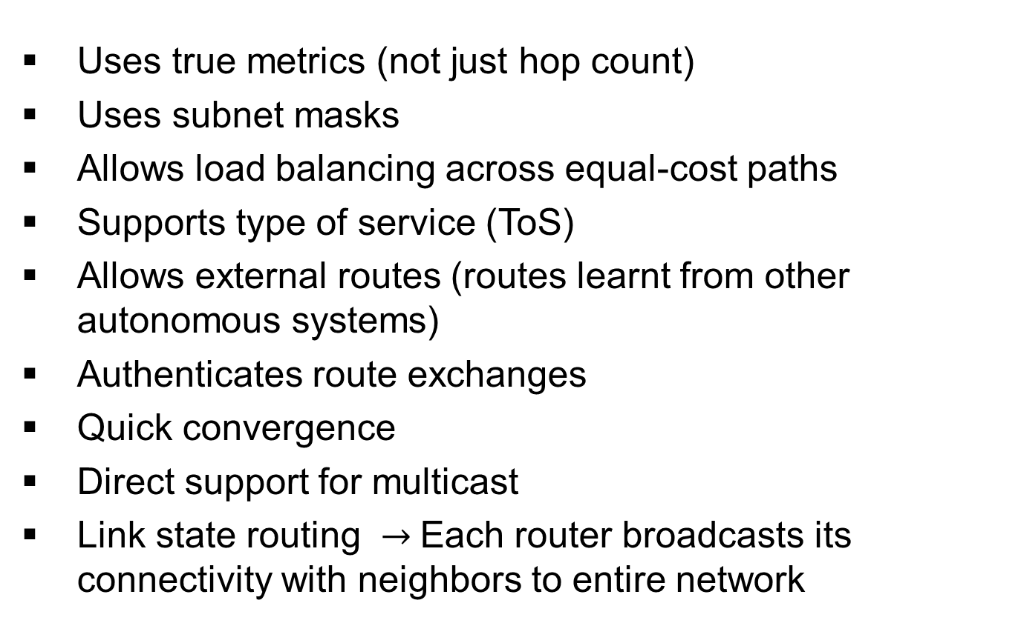
Open Shortest Path First (OSPF)
Uses true metrics (not just hop count)
Uses subnet masks
Allows load balancing across equal-cost paths
Supports type of service (ToS)
Allows external routes (routes learnt from other autonomous systems)
Authenticates route exchanges
Quick convergence
Direct support for multicast
Link state routing $→$Each router broadcasts its connectivity with neighbors to entire network

Slide 52
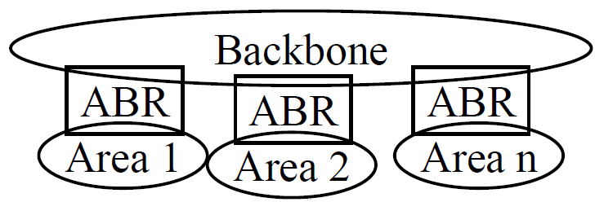
OSPF Areas
Large networks are divided into areas to reduce routing traffic.
LSAs are flooded throughout the area
Area border routers (ABRs) summarize the topology and transmit it to the backbone area
Backbone routers forward it to other areas
ABRs connect an area with the backbone area. ABRs contain OSPF data for two areas. ABRs run OSPF algorithms for the two areas.
If there is only one area in the AS, there is no backbone area and there are no ABRs.

Slide 53
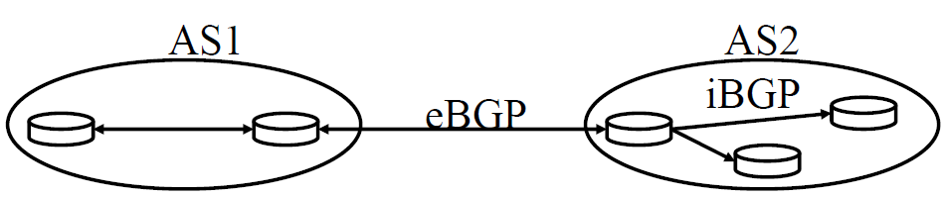
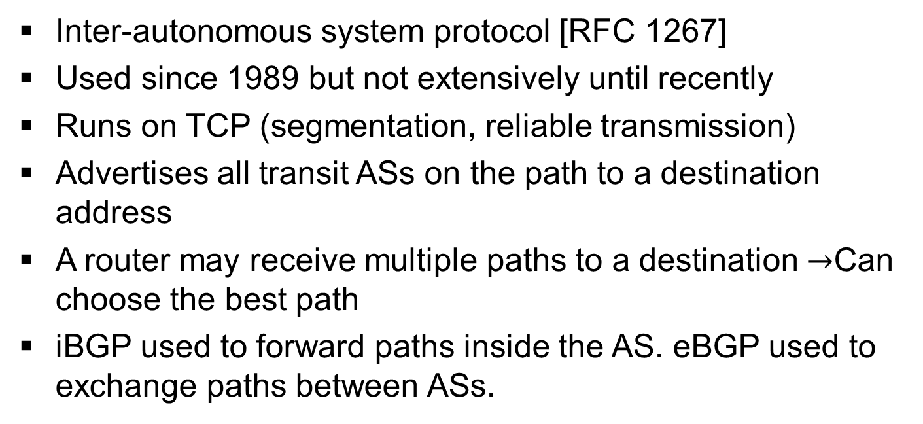
Border Gateway Protocol
Inter-autonomous system protocol [RFC 1267]
Used since 1989 but not extensively until recently
Runs on TCP (segmentation, reliable transmission)
Advertises all transit ASs on the path to a destination address
A router may receive multiple paths to a destination $→$Can choose the best path
iBGP used to forward paths inside the AS. eBGP used to exchange paths between ASs.

Slide 54
BGP Operations
BGP systems initially exchange entire routing tables. Afterwards, only updates are exchanged.
BGP messages have the following information:
Origin of path information: RIP, OSPF, …
AS_Path: List of ASs on the path to reach the dest
Next_Hop: IP address of the border router to be used as the next hop to reach the dest
Unreachable: If a previously advertised route has become unreachable
BGP speakers generate update messages to all peers when it selects a new route or some route becomes unreachable.

Slide 55
BGP routing policy
legend:
provider
B
network
X
W
A
customer
C
network:
Y
A,B,C are provider networks
X,W,Y are customer (of provider networks)
X is dual-homed: attached to two networks
X does not want to route from B via X to C
.. so X will not advertise to B a route to C

Slide 56
BGP routing policy (2)
legend:
provider
B
network
X
W
A
customer
C
network:
Y
A advertises path AW to B
B advertises path BAW to X
Should B advertise path BAW to C?
No way! B gets no “revenue” for routing CBAW since neither W nor C are B’s customers
B wants to force C to route to w via A
B wants to route only to/from its customers!

Slide 57
Why different Intra-, Inter-AS routing ?
Policy:
inter-AS: admin wants control over how its traffic routed, who routes through its net.
intra-AS: single admin, so no policy decisions needed
Scale:
hierarchical routing saves table size, reduced update traffic
Performance:
intra-AS: can focus on performance
inter-AS: policy may dominate over performance

Slide 58
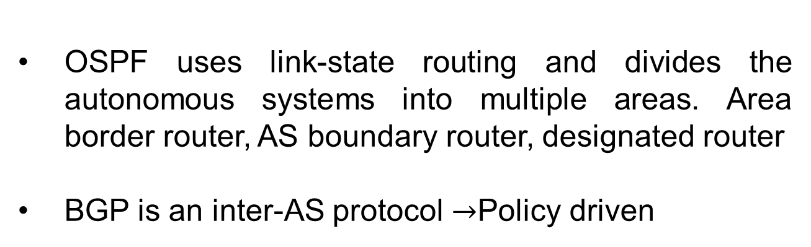
Summary
OSPF uses link-state routing and divides the autonomous systems into multiple areas. Area border router, AS boundary router, designated router
BGP is an inter-AS protocol $→$Policy driven

Slide 59
Chapter 4: outline
4.1 introduction
4.2 virtual circuit and datagram networks
4.3 what’s inside a router
4.4 IP: Internet Protocol
datagram format
IPv4 addressing
ICMP
IPv6
4.5 routing algorithms
link state
distance vector
hierarchical routing
4.6 routing in the Internet
RIP
OSPF
BGP
4.7 broadcast and multicast routing

Slide 60
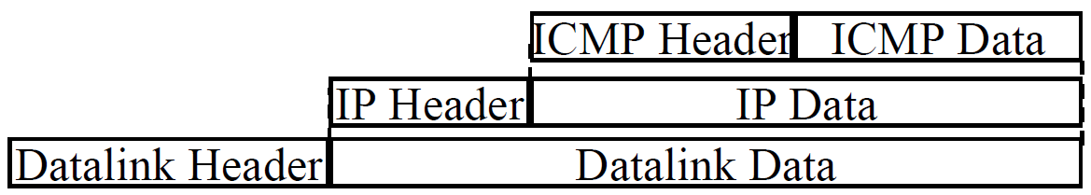
ICMP
Internet Control Message Protocol
Required companion to IP. Provides feedback from the network.
ICMP: Used by IP to send error and control messages
ICMP uses IP to send its messages (Not UDP)
ICMP does not report errors on ICMP messages.
ICMP reports error only on the first fragment

Slide 61
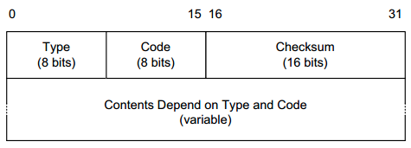
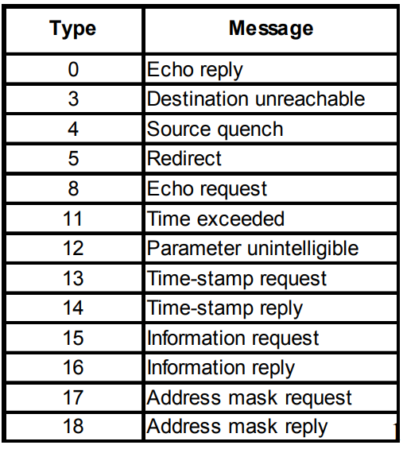
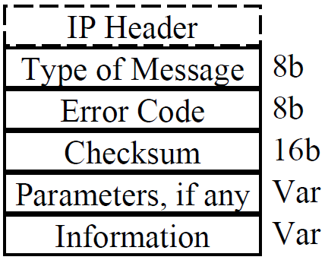
ICMP: Message Types

Slide 62
ICMP Messages
Source Quench: Please slow down! I just dropped one of your datagrams.
Time Exceeded: Time to live field in one of your packets became zero.” or “Reassembly timer expired at the destination.
Fragmentation Required: Datagram was longer than MTU and “No Fragment bit” was set.
Address Mask Request/Reply: What is the subnet mask on this net? Replied by “Address mask agent”
PING uses ICMP echo
Tracert uses TTL expired

Slide 63
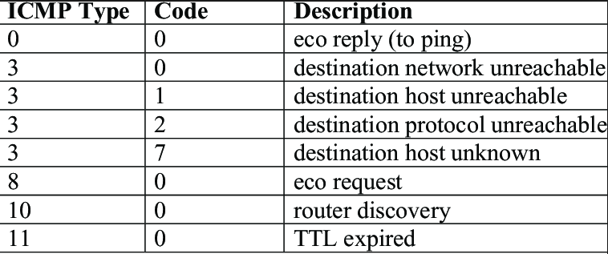

Slide 64
Network Management
What is Network Management?
Components of Network Management
How is Network Managed?
SNMP protocol

Slide 65
What is Network Management?
Traffic on Network = Data + Control + Management
Data = Bytes/Messages sent by users
Control = Bytes/messages added by the system to properly transfer the data (e.g., routing messages)
Management = Optional messages to ensure that the network functions properly and to handle the issues arising from malfunction of any component
If all components function properly, control is still required but management is optional.
Examples:
Detecting failures of an interface card at a host or a router
Monitoring traffic to aid in resource deployment
Intrusion Detection

Slide 66
Components of Network Management
Fault Management: Detect, log, and respond to fault conditions
Configuration Management: Track and control which devices are on or off
Accounting Management: Monitor resource usage for records and billing
Performance Management: Measure, report, analyze, and control traffic, messages
Security Management: Enforce policy for access control, authentication, and authorization
FCAPS

Slide 67
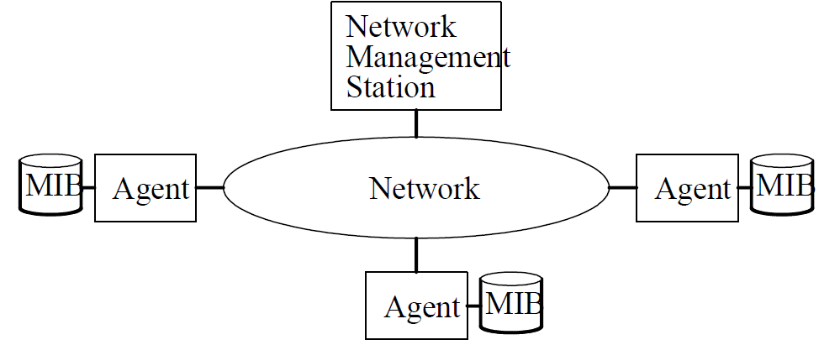
How is Network Managed?
Management = Initialization, Monitoring, Control
Manager, Agents, and Management Information Base (MIB)

Slide 68
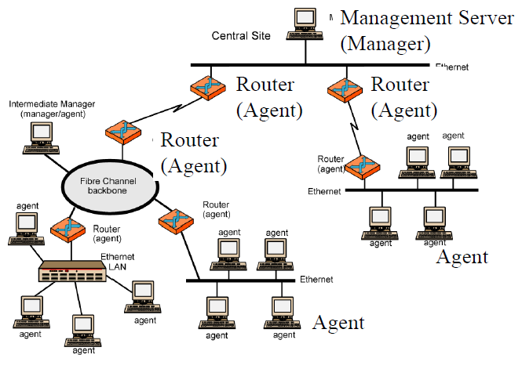
Example of Network Management
A MIB is defined for each device

Slide 69
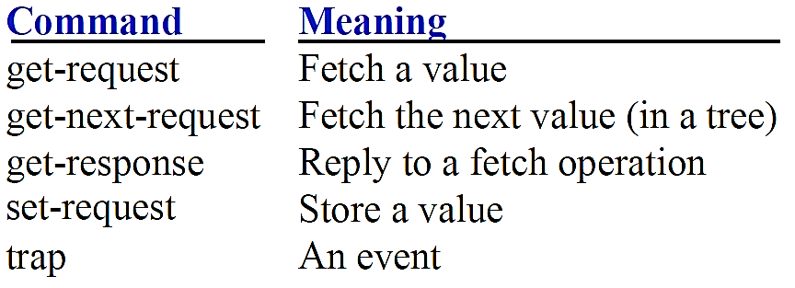
Based on Simple Gateway Management Protocol (SGMP) – RFC 1028 – Nov 1987
SNMP = Simply Not My Problem [Marshall Rose] Simple Network Management Protocol
RFC 1058, April 1988
Only Five commands

Slide 70
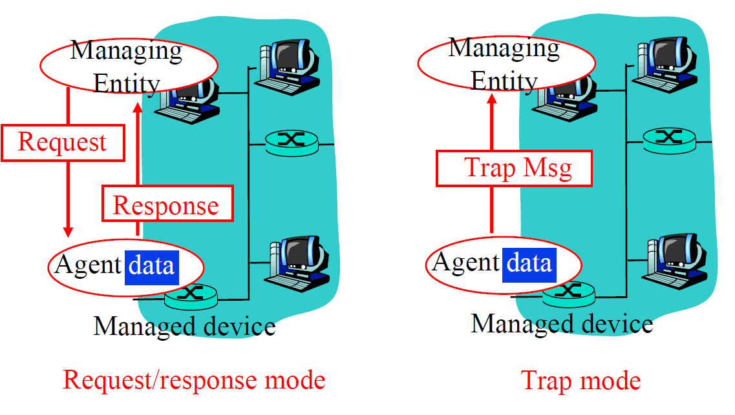
SNMP protocol
Two ways to convey MIB info, commands:

Slide 71
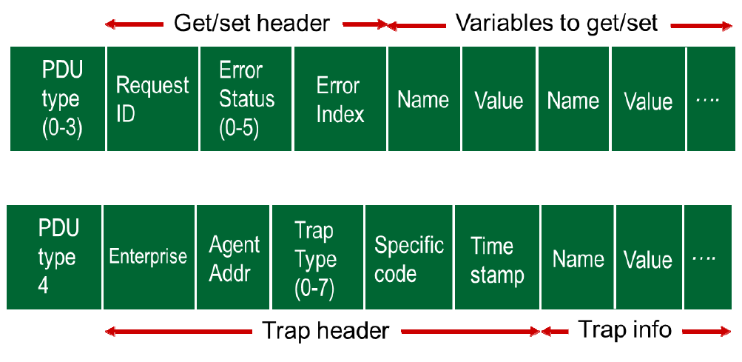
SNMP Message Formats
SNMP PDU

Slide 72
SNMP Summary
Management = Initialization, Monitoring, and Control
Standard MIBs defined for each object
SNMP = Only 5 commands in the first version

Slide 73
Network Layer Summary
Dijkstra’s algorithm allows path computation using link state
Bellman Ford’s algorithm allows path computation using distance vectors.
OSPF is a link state IGP.
BGP is an EGP and uses path vectors
SDN controllers use various algorithms for centralized computation of path and other policies
ICMP is IP control protocol is used to convey errors
SNMP is the simple network management protocol to manage all devices and protocols in a network

Slide 74
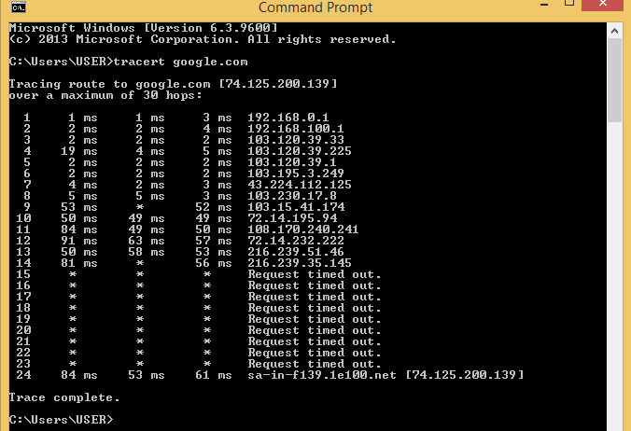

Slide 75
Broadcast routing
deliver packets from source to all other nodes
source duplication is inefficient:
duplicate
duplicate
creation/transmission
R1
R1
duplicate
R2
R2
R3
R4
R3
R4
source duplication
in-network
duplication
source duplication: how does source determine recipient addresses?

Slide 76
In-network duplication
flooding: when node receives broadcast packet, sends copy to all neighbors
problems: cycles & broadcast storm
controlled flooding: node only broadcasts pkt if it hasn’t broadcast same packet before
node keeps track of packet ids already broadacsted
or reverse path forwarding (RPF): only forward packet if it arrived on shortest path between node and source
spanning tree:
no redundant packets received by any node

Slide 77
Spanning tree
first construct a spanning tree
nodes then forward/make copies only along spanning tree
A
A
B
B
c
c
D
D
F
E
F
E
G
G
(a) broadcast initiated at A
(b) broadcast initiated at D

Slide 78
Spanning tree: creation
center node
each node sends unicast join message to center node
message forwarded until it arrives at a node already belonging to spanning tree
A
A
3
B
B
c
c
4
2
D
D
F
E
F
E
1
5
G
G
stepwise construction of spanning tree (center: E)
(b) constructed spanning tree

Slide 79



Multicast routing: problem statement
goal: find a tree (or trees) connecting routers having local mcast group members
tree: not all paths between routers used
shared-tree: same tree used by all group members
legend
group
member
source-based: different tree from each sender to rcvrs
not group
member
router
with a
group
member
router
without
group
member
shared tree
source-based trees
Notes:
Notes:
3.3 Network Layer: Multicast Routing Algorithms 3-9

Slide 80
Approaches for building mcast trees
approaches:
source-based tree: one tree per source
shortest path trees
reverse path forwarding
group-shared tree: group uses one tree
minimal spanning (Steiner)
center-based trees
…we first look at basic approaches, then specific protocols adopting these approaches
Notes:
Notes:
3.3 Network Layer: Multicast Routing Algorithms 3-11

Slide 81
Shortest path tree
mcast forwarding tree: tree of shortest path routes from source to all receivers
Dijkstra’s algorithm
s: source
LEGEND
R1
2
router with attached
group member
1
R4
R2
5
router with no attached
group member
3
4
R5
6
i
link used for forwarding,
i indicates order link
added by algorithm
R3
R6
R7
Notes:
Notes:
3.3 Network Layer: Multicast Routing Algorithms 3-12

Slide 82
Reverse path forwarding
rely on router’s knowledge of unicast shortest path from it to sender
each router has simple forwarding behavior:
if (mcast datagram received on incoming link on shortest path back to center)
then flood datagram onto all outgoing links
else ignore datagram
Notes:
Notes:
3.3 Network Layer: Multicast Routing Algorithms 3-13

Slide 83
Reverse path forwarding: example
s: source
LEGEND
R1
R4
router with attached
group member
R2
router with no attached
group member
R5
R3
datagram will be forwarded
R6
R7
datagram will not be
forwarded
result is a source-specific reverse SPT
may be a bad choice with asymmetric links
Notes:
Notes:
3.3 Network Layer: Multicast Routing Algorithms 3-14

Slide 84
Reverse path forwarding: pruning
forwarding tree contains subtrees with no mcast group members
no need to forward datagrams down subtree
“prune” msgs sent upstream by router with no downstream group members
s: source
R1
LEGEND
R4
router with attached
group member
R2
P
router with no attached
group member
R5
P
R3
P
prune message
R6
links with multicast
forwarding
R7
Notes:
Notes:
3.3 Network Layer: Multicast Routing Algorithms 3-15

Slide 85
Shared-tree: steiner tree
steiner tree: minimum cost tree connecting all routers with attached group members
problem is NP-complete
excellent heuristics exists
not used in practice:
computational complexity
information about entire network needed
monolithic: rerun whenever a router needs to join/leave
Notes:
Notes:
1. See L. Wei and D. Estrin, “A Comparison of multicast trees and algorithms,” TR USC-CD-93-560, Dept. Computer Science, University of California, Sept 1993 for a comparison of heuristic approaches.
3.3 Network Layer: Multicast Routing Algorithms 3-16

Slide 86
Center-based trees
single delivery tree shared by all
one router identified as “center” of tree
to join:
edge router sends unicast join-msg addressed to center router
join-msg “processed” by intermediate routers and forwarded towards center
join-msg either hits existing tree branch for this center, or arrives at center
path taken by join-msg becomes new branch of tree for this router
Notes:
Notes:
1. It’s always nice to see a PhD dissertation with impact. The earliest discussion of center-based trees for multicast appears to be D. Wall, “Mechanisms for Broadcast and Selective Broadcast,” PhD dissertation, Stanford U., June 1980.
3.3 Network Layer: Multicast Routing Algorithms 3-17

Slide 87
Center-based trees: example
suppose R6 chosen as center:
LEGEND
R1
router with attached
group member
R4
3
R2
router with no attached
group member
2
R5
1
path order in which join messages generated
R3
1
R6
R7
Notes:
Notes:
3.3 Network Layer: Multicast Routing Algorithms 3-18

Slide 88
Internet Multicasting Routing: DVMRP
DVMRP: distance vector multicast routing protocol, RFC1075
flood and prune: reverse path forwarding, source-based tree
RPF tree based on DVMRP’s own routing tables constructed by communicating DVMRP routers
no assumptions about underlying unicast
initial datagram to mcast group flooded everywhere via RPF
routers not wanting group: send upstream prune msgs
Notes:
Notes:
D. Waitzman, S. Deering, C. Partridge, “Distance Vector Multicast Routing Protocol,” RFC 1075, Nov. 1988. The version of DVMRP in use today is considerably enhanced over the RFC1075 spec.
A more up-to-date “work-in-progress” defines a version 3 of DVMRP: T. Pusateri, “Distance Vector Multicast Routing Protocol,” work-in-progress, draft-ietf-idmr-v3-05.ps
3.4 Network Layer: Internet Multicast Routing Algorithms 3-20

Slide 89
DVMRP: continued…
soft state: DVMRP router periodically (1 min.) “forgets” branches are pruned:
mcast data again flows down unpruned branch
downstream router: reprune or else continue to receive data
routers can quickly regraft to tree
following IGMP join at leaf
odds and ends
commonly implemented in commercial router
Notes:
Notes:
1. See www.mbone.com/mbone/routers.html for a (slightly outdatet) list of multicast capable routers (supporting DVMPR as well as other protocols) from various vendors.
2. ftp://parcftp.xerox.com/pub/net-research/ipmulti for circa 1996 public copy “mrouted” v3.8 of DVMRP routing software for various workstation routing platforms.
3.4 Network Layer: Internet Multicast Routing Algorithms 3-21

Slide 90
Tunneling
Q: how to connect “islands” of multicast routers in a “sea” of unicast routers?
physical topology
logical topology
mcast datagram encapsulated inside “normal” (non-multicast-addressed) datagram
normal IP datagram sent thru “tunnel” via regular IP unicast to receiving mcast router (recall IPv6 inside IPv4 tunneling)
receiving mcast router unencapsulates to get mcast datagram
Notes:
Notes:
For a general discussion of IP encapsulation, see C. Perkins, “IP Encapsulation within IP,” RFC 2003, Oct. 1996.
The book S. Bradner, A Mankin, “Ipng: Internet protocol next generation,” Addison Wesley, 1995 has a very nice discussion of tunneling
Tunneling can also be used to connect islands of IPv6 capable routers in a sea IPv4 capable routers. The long term hope is that the sea evaporates leaving only lands of IPv6!
3.4 Network Layer: Internet Multicast Routing Algorithms 3-22

Slide 91
PIM: Protocol Independent Multicast
not dependent on any specific underlying unicast routing algorithm (works with all)
two different multicast distribution scenarios :
dense:
group members densely packed, in “close” proximity.
bandwidth more plentiful
sparse:
# networks with group members small wrt # interconnected networks
group members “widely dispersed”
bandwidth not plentiful
Notes:
Notes:
a very readable discussion of the PIM architecture is S. Deering, D. Estrin, D. Faranacci, V. Jacobson, C. Liu, L. Wei, “The PIM Architecture for Wide Area Multicasting,” IEEE/ACM Transactions on Networking, Vol. 4, No. 2, April 1996.
D. Estrin et al, PIM-SM: Protocol Specification, RFC 2117, June 1997
S. Deering et al, PIM Version 2, Dense Mode Specification, work in progress, draft-ietf-idmr-pim-dm-05.txt
PIM is implemented in Cisco routers and has been deployed in UUnet as part of their streaming multimedia delivery effort. See S. LaPolla, “IP Multicast makes headway among ISPs,” PC Week On-Line, http://www.zdnet.com/pcweek/news/1006/06isp.html
3.4 Network Layer: Internet Multicast Routing Algorithms 3-25

Slide 92
Consequences of sparse-dense dichotomy:
dense
group membership by routers assumed until routers explicitly prune
data-driven construction on mcast tree (e.g., RPF)
bandwidth and non-group-router processing profligate
sparse:
no membership until routers explicitly join
receiver- driven construction of mcast tree (e.g., center-based)
bandwidth and non-group-router processing conservative
Notes:
Notes:
3.4 Network Layer: Internet Multicast Routing Algorithms 3-26

Slide 93
PIM- dense mode
flood-and-prune RPF: similar to DVMRP but…
underlying unicast protocol provides RPF info for incoming datagram
less complicated (less efficient) downstream flood than DVMRP reduces reliance on underlying routing algorithm
has protocol mechanism for router to detect it is a leaf-node router
Notes:
Notes:
3.4 Network Layer: Internet Multicast Routing Algorithms 3-27

Slide 94
PIM - sparse mode
center-based approach
router sends join msg to rendezvous point (RP)
intermediate routers update state and forward join
after joining via RP, router can switch to source-specific tree
increased performance: less concentration, shorter paths
R1
R4
join
R2
join
R5
join
R3
R6
all data multicast
from rendezvous
point
R7
rendezvous
point
Notes:
Notes:
3.4 Network Layer: Internet Multicast Routing Algorithms 3-28

Slide 95
PIM - sparse mode
sender(s):
unicast data to RP, which distributes down RP-rooted tree
RP can extend mcast tree upstream to source
RP can send stop msg if no attached receivers
“no one is listening!”
R1
R4
join
R2
join
R5
join
R3
R6
all data multicast
from rendezvous
point
R7
rendezvous
point
Notes:
Notes:
3.4 Network Layer: Internet Multicast Routing Algorithms 3-29

Slide 96
Chapter 4: Summary
4.1 introduction
4.2 virtual circuit and datagram networks
4.3 what’s inside a router
4.4 IP: Internet Protocol
datagram format, IPv4 addressing, ICMP, IPv6
4.5 routing algorithms
link state, distance vector, hierarchical routing
4.6 routing in the Internet
RIP, OSPF, BGP
4.7 broadcast and multicast routing
understand principles behind network layer services:
network layer service models, forwarding versus routing how a router works, routing (path selection), broadcast, multicast
instantiation, implementation in the Internet

